Slide 1




GEOPASTURE
DIGITAL SOLUTIONS FOR AGRICULTURALISTS AND PASTORALISTS

Slide 2




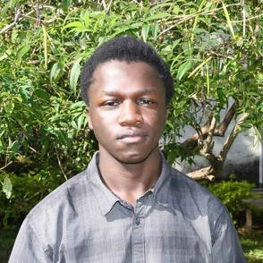

MEET THE TEAM
GET TO KNOW US BETTER
01
04
SAM KELLY
FAITH MOSONIK
Project lead
Backend Developer
05
MELANIE MINAYO
02
JOAN KINOTI
UI/UX Designer
Frontend Developer
MOSES ODENY
06
LYNN NYANDUKO
03
Android Developer
UI/UX Designer

Slide 3
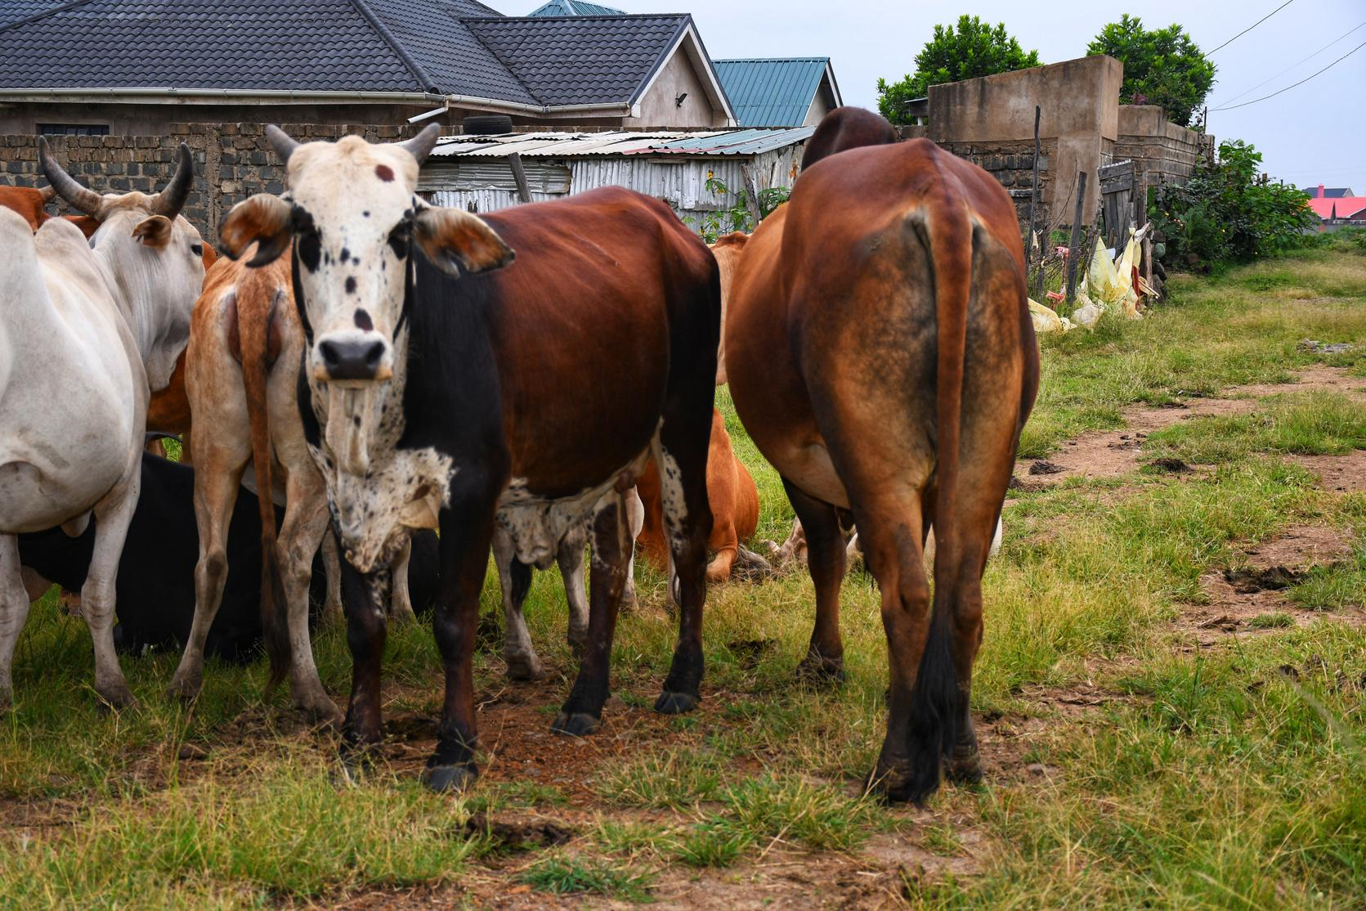
PROBLEM AT HAND
Resource Conflict amongst pastoralists and agriculturalists
In many parts of Kenya, conflicts over grazing lands, water resources, and environmental degradation have strained pastoralist and agriculturalist relationships.

Slide 4

SOLUTION
WE PRESENT TO YOU GEOPASTURE!
GeoPasture is a mobile application that aims to foster peaceful coexistence between pastoralists and pasture by providing real-time updates on pasture availability, weather forecasts, and GPS-enabled tracking of animals thus empowering stakeholders to make informed decisions.
GeoPasture

Slide 5

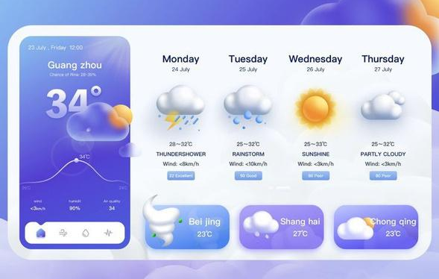

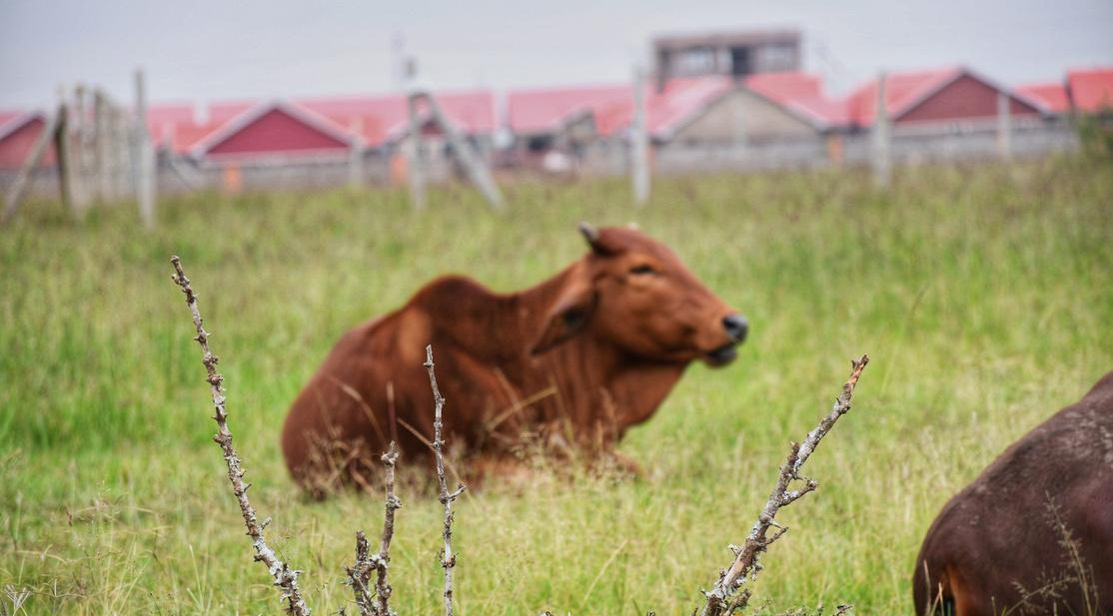
KEY FEATURES
GeoPasture
WHAT ARE WE OFFERING?
Real-Time Pasture updates
Weather Forecasts
The app will provides real-time updates on pasture availability by integrating data from satellite imagery.
We will provide users with accurate and up-to-date weather information for their specific geographical locations.

Slide 6
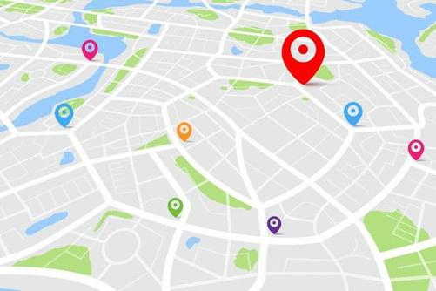
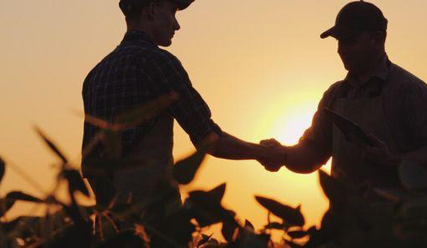
KEY FEATURES
GeoPasture
WHAT ARE WE OFFERING?
Marketing Platform
GPS Tracking of Animals
GPS tracking functionality enables users to monitor and track the movement of their animals in real-time.
This platform will empower users to efficiently market and sell their farm produce and livestock, enhancing their economic opportunities and market reach.

Slide 7
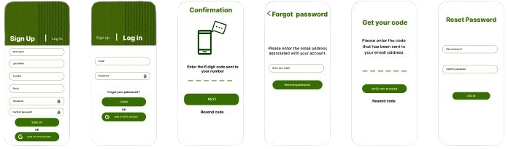

HOW IT WORKS
GeoPasture
HOW DOES THE UI LOOK LIKE?
These are the registration pages for the users where they can sign up, login, verify their identity and reset password in the case where they have forgotten it.

Slide 8
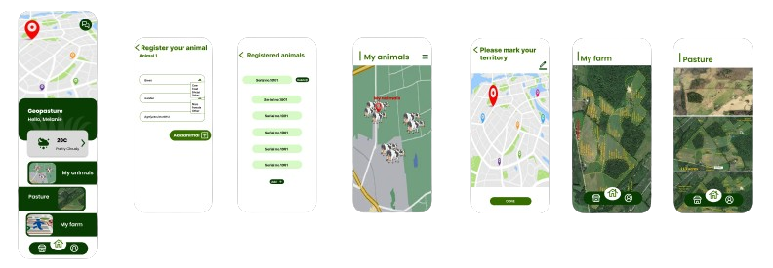
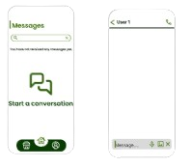
HOW IT WORKS
GeoPasture
HOW DOES THE UI LOOK LIKE?
Here, they register their animals and can view them and track them as well
Here, the user can geofence and mark the desired territory and view it.
Here, the users can communicate directly to each other within the app
Here, they register their animals and can view them and track them as well
Here, the user can view the pasture available at a given place at a given time

Slide 9
IMPACT AND SUSTAINABILITY
GeoPasture
WHAT BENEFIT DOES GEOPASTURE BRING TO THE TABLE?
Improved decision-making on grazing and migration patterns due to real-time updates of pasture availability
Reduced risk of conflict and loss of livestock as a result of live tracking of animals.
Early warning systems for potential livestock incursions due to the Geofencing capabilities within the application.
Opportunities for collaboration and shared benefits in our market platform and direct messaging feature.

Slide 10
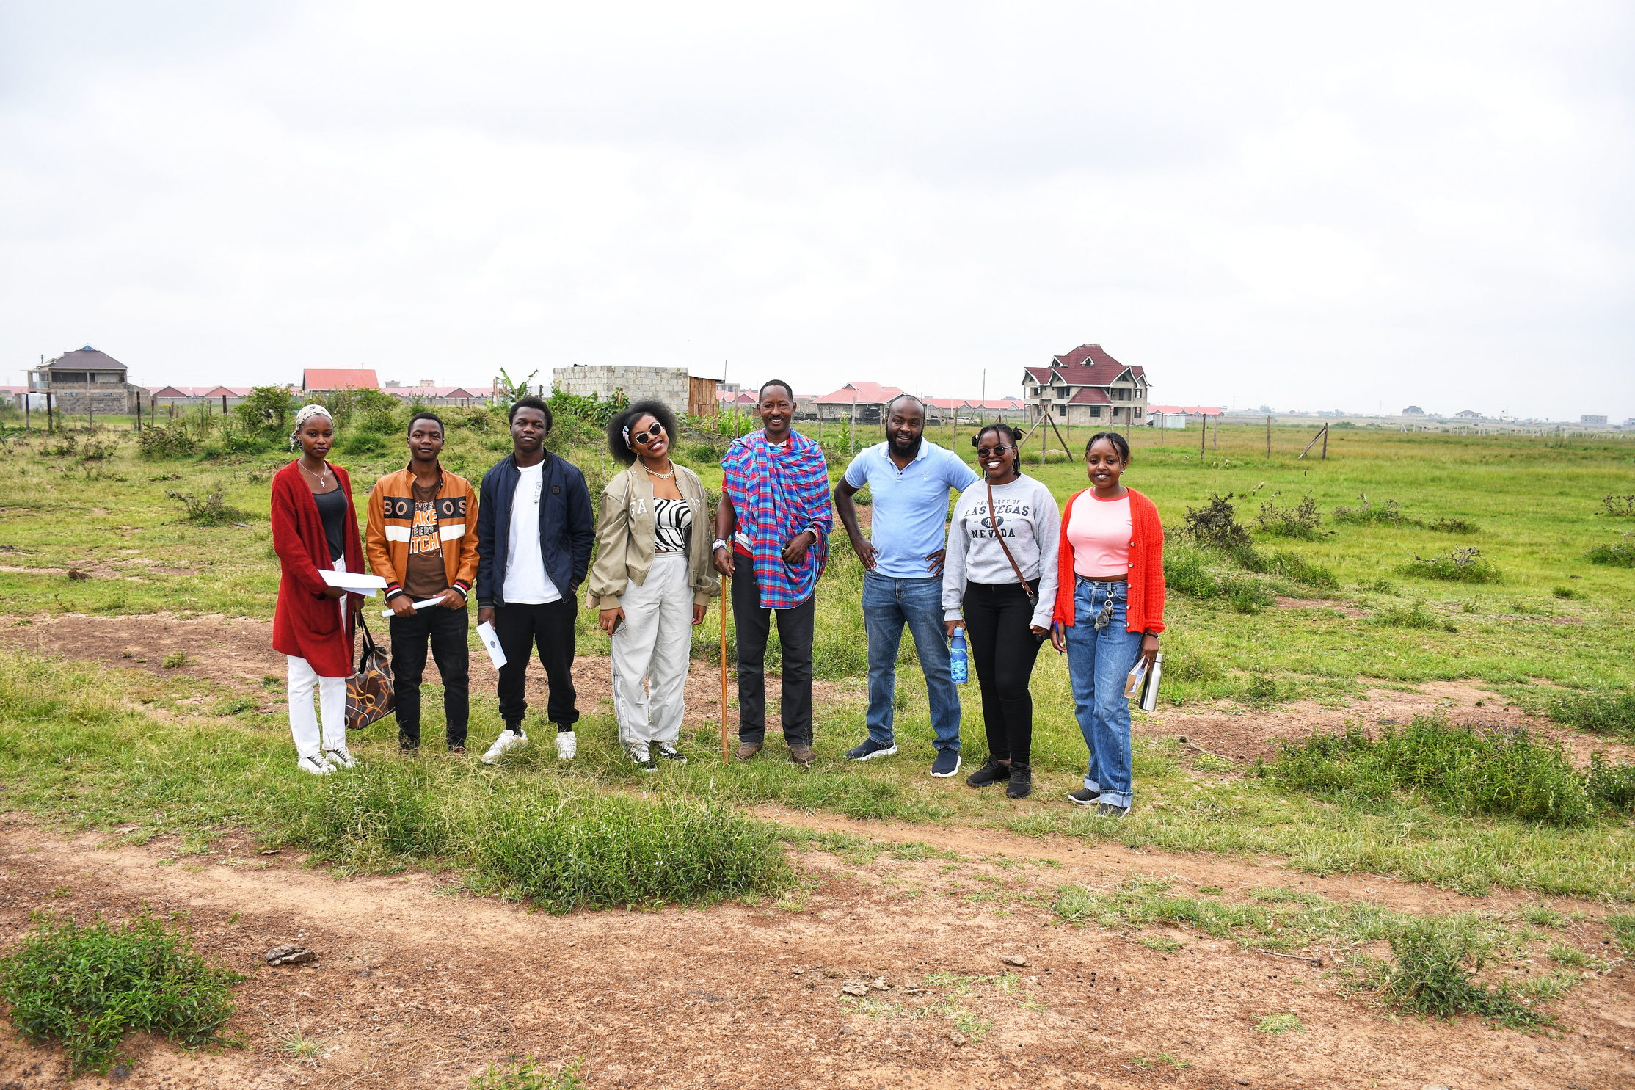

GeoPasture
THANK YOU!

